Slide 1

Dissertation Work
on
AI BASED SECURITY SOLUTION
FOR DATA ENCRYPTION USING AES ALGORITHM
By
Bee Fathima
(23261DA902)
Under the Guidance of
A. Ratna Raju
(Assitent Professor)
Department of Computer Science and Engineering
MAHATMA GANDHI INSTITUTE OF TECHNOLOGY(A)
2024 – 2025

Slide 2
Abstract
This project presents an AI-driven data security framework that integrates AES encryption with AI-based intrusion detection. It uses a MANN optimized by Modified Particle Swarm Optimization (MPSO) to classify and filter malicious content. Secure data is encrypted using AES + RSA and concealed using steganography before being stored in the cloud — ensuring confidentiality, integrity, and privacy.

Slide 3
Problem definition
In the era of cloud computing and data-driven systems, securing sensitive information is critical.
Traditional encryption systems lack adaptability, and prevent unauthorized or malicious data from being stored or transmitted.
This project focuses on enhancing data security by integrating AI with the AES encryption technique.
the system proactively adapts to emerging risks, automatic decision-making, and maintains strong data confidentiality, integrity, and availability. also detects potential threats in real-time before data is stored or transmitted.

Slide 4
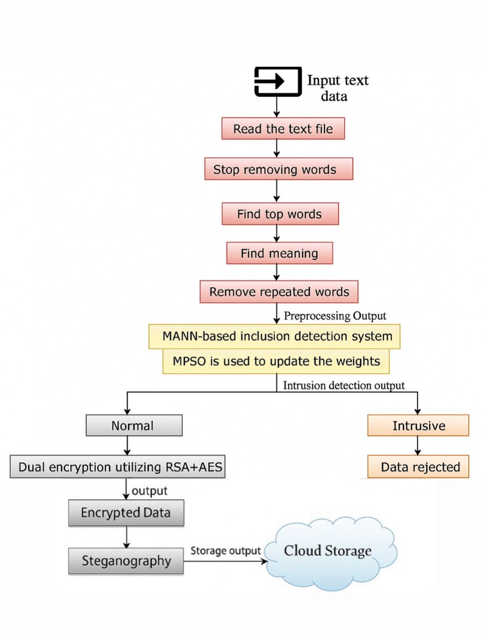
Design

Slide 5
Cont..
System Design (Flow Summary)
Input Text Data
Preprocessing: stop words, find top words, finding meaning, removing repeated words
Intrusion Detection: MANN + MPSO filters malicious content.
Encryption: Valid data is encrypted with AES and RSA.
Steganography: Encrypted data is hiding
Cloud Storage: Data is securely stored and accessed via authentication.

Slide 6
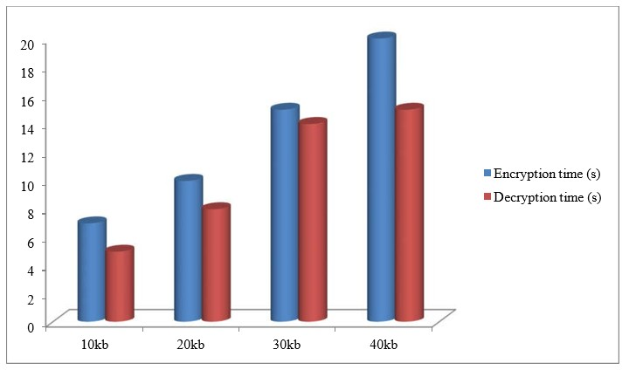
Results
Improved Encryption & Decryption Time
High Accuracy in Threat Detection
Enhanced Security Against Attacks
Strong Key Protection
Efficient Resource Utilization
Better Fitness and Learning Models
Encryption and Decryption Frequency

Slide 7
COMPARISON – EXISTING VS PROPOSED SYSTEM
Aspect | Existing System | Proposed System
Intrusion Detection | Not included or rule-based only | AI-based using (MANN)
Adaptability | Static logic, can't learn or adapt | Learns from past attacks using memory + optimization
Optimization | No optimization or manual tuning | Uses Modified Particle Swarm Optimization (MPSO)
Encryption Method | Single-layer AES or RSA | Dual encryption using RSA + AES
Data Preprocessing | Basic or none | Semantic analysis, keyword extraction, stop word retention
Malicious Data Handling | Encrypted and stored without analysis | Detected and rejected before encryption
Accuracy | Moderate to low | High detection accuracy (93.54%)
Attack Resistance | Vulnerable to DoS, MITM | Strong resistance due to layered security

Slide 8
Conclusion
This project combines AI with AES encryption to create an intelligent, adaptive, and secure data protection system. AI models detect threats in real time, while dual encryption ensure data confidentiality. The system reduces human error, enhances performance, and is well-suited for real-time use in fields like IoT, healthcare, autonomous vehicles, and cloud security.

Slide 9
THANK YOU

